Slide 1
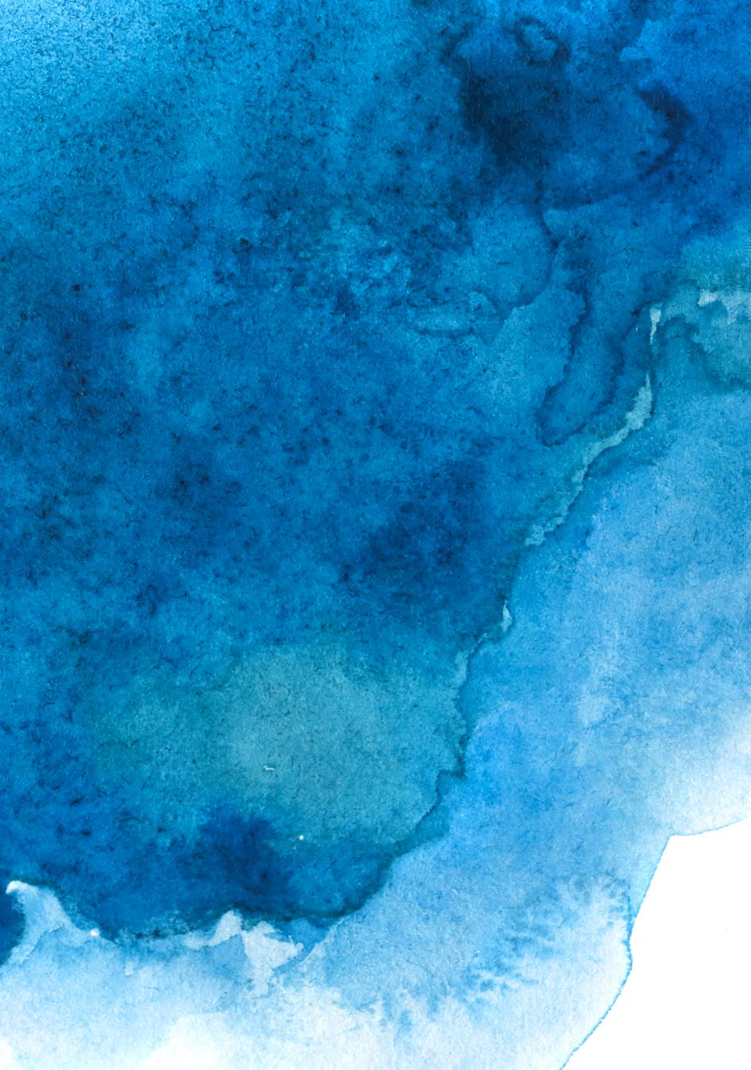

Slide 2
Algorithm
Load Images
Splitting dataset
Training 85%, Validation 10%, Testing 5%
Dimensional reduction PCA
Ensemble methods Majority Voting
Gradient Boosting
Classifiers - Best Parameters:
SVC (supported vector machine)
KNN (K Near Neighbors)
RF (Random Forest)
Image preprocessing
Resize (128x128)
HSV (Hue Saturation Value)
HOG (Histogram of Oriented Gradients)
RGB (Red Green Blue)
LAB (Light components A and B)
EDA
Info
Dropna
Cross Validation (each model)
Training and validation
Testing set
Model Evaluation ROC AUC

Slide 3
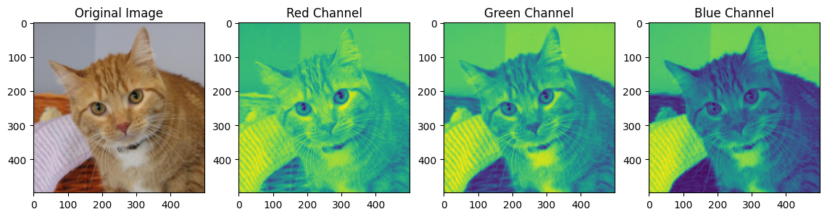
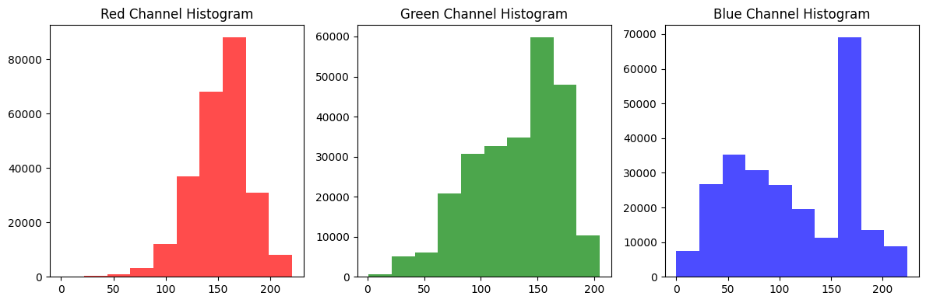
Image Preprocessing RGB

Slide 4
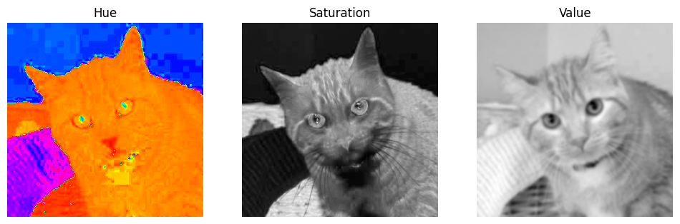
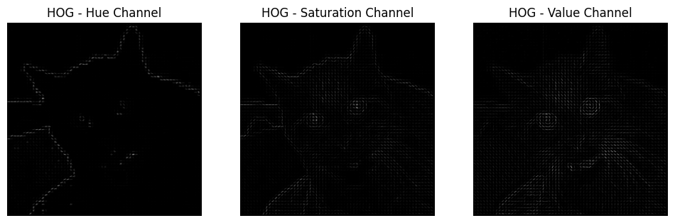
Image Preprocessing HSV + HOG

Slide 5
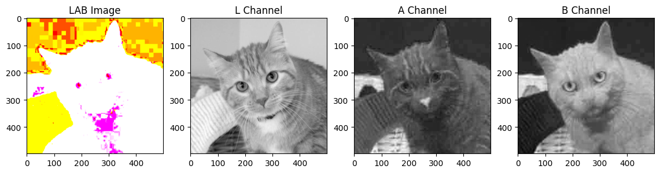
Image Preprocessing LAB

Slide 6
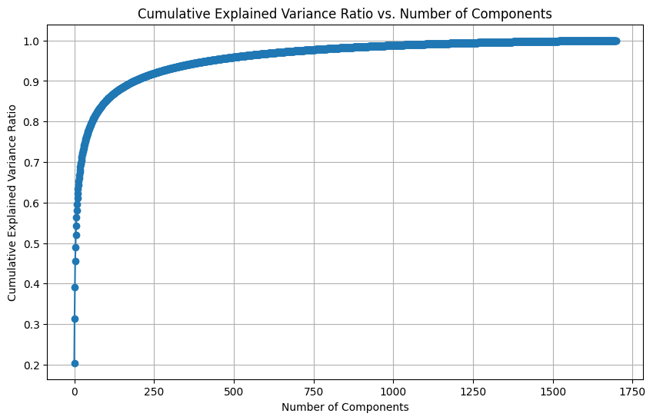
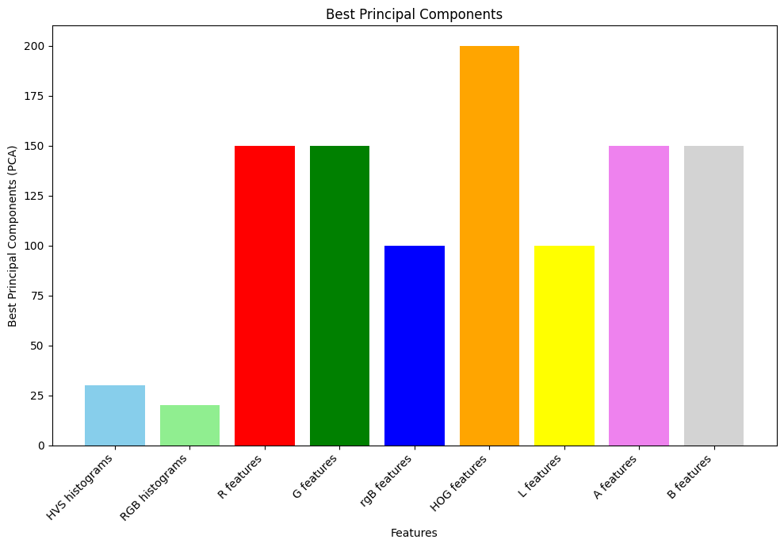
Dimensional reduction

Slide 7
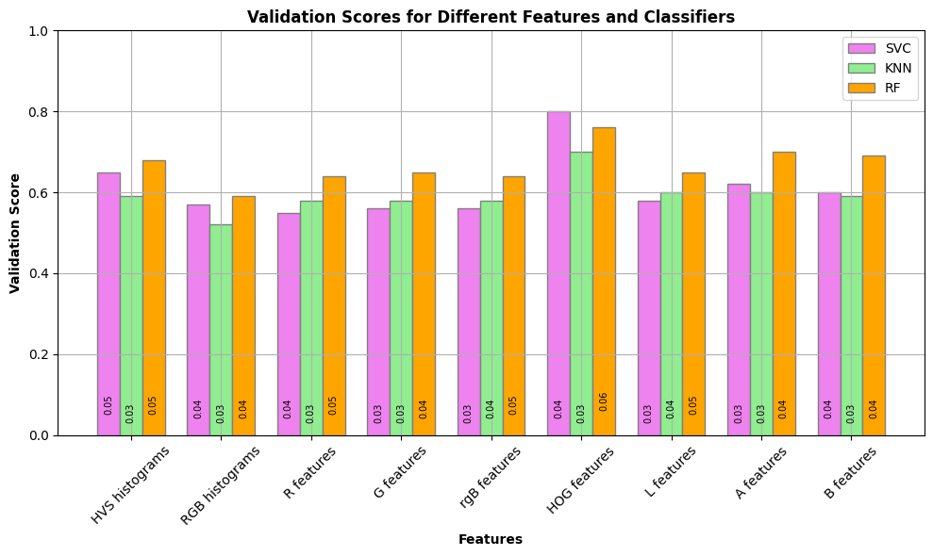
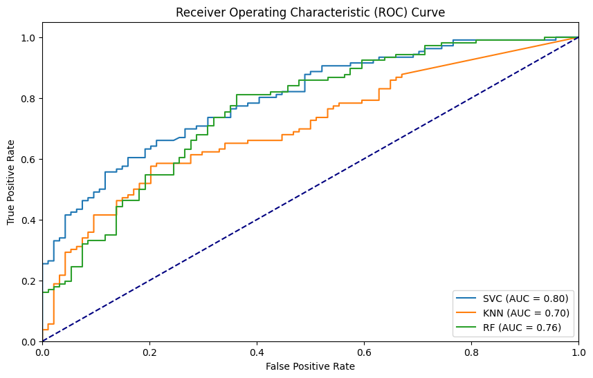
ROC - AUC
Classifiers: Support Vector Classifier (SVC)
K-Nearest Neighbors (KNN)
Random Forest (RF)

Slide 8
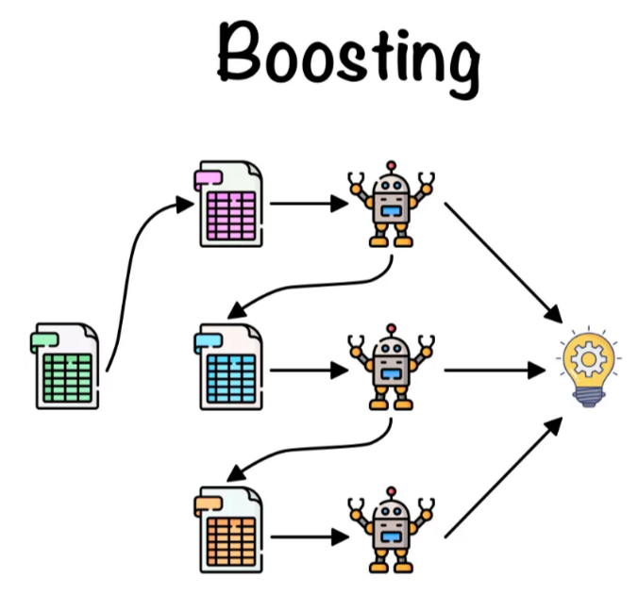
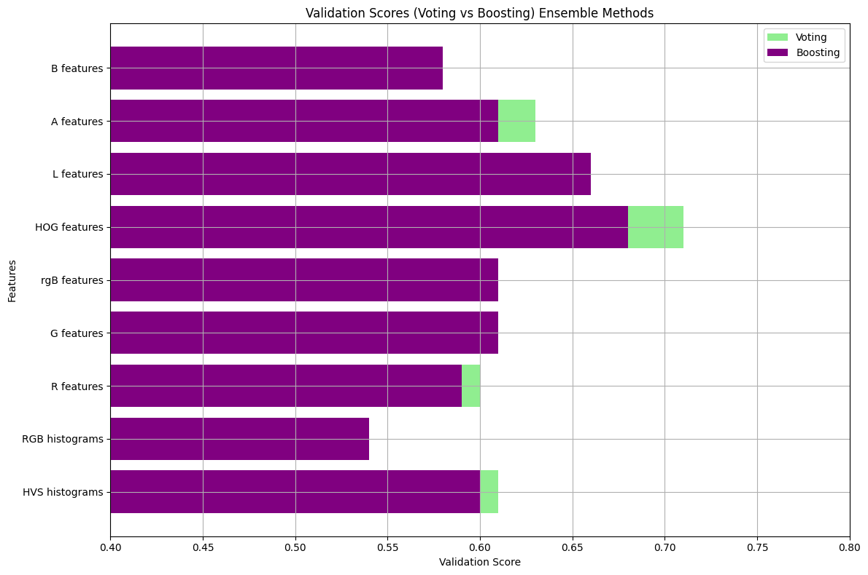
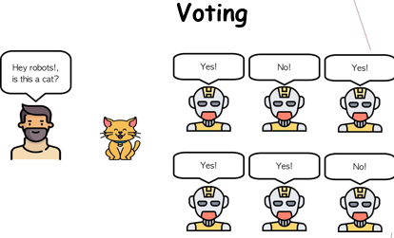
Ensemble methods

Slide 9
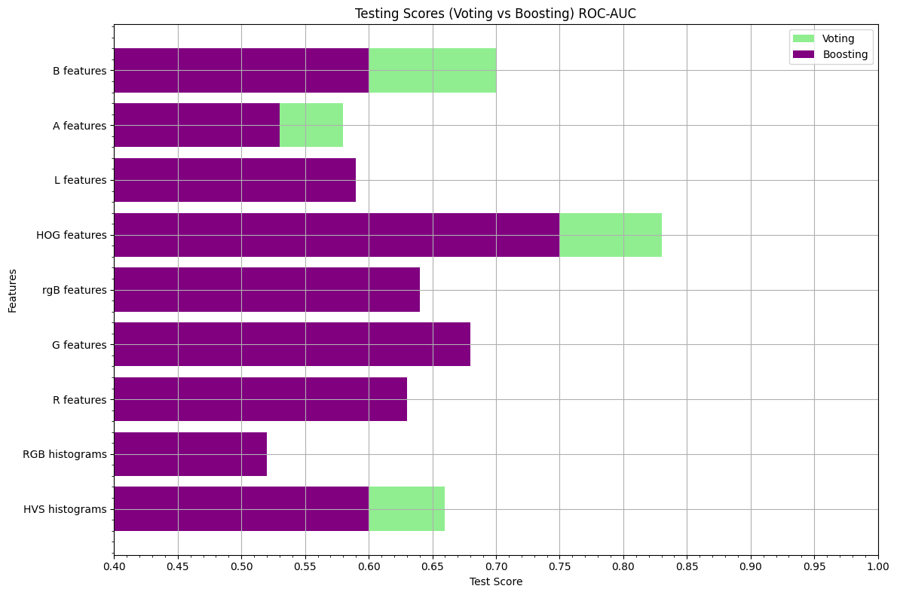
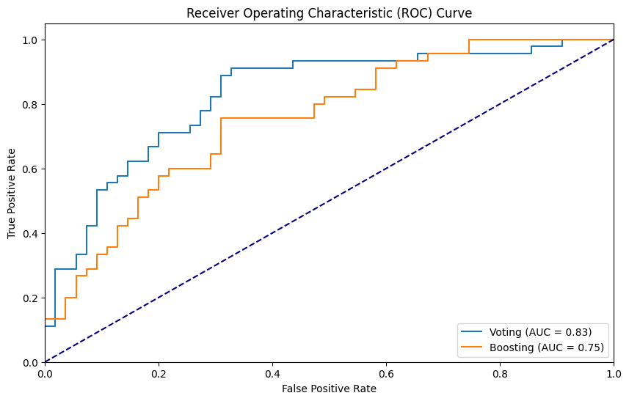
Evaluating Test set

